Slide 1

Innovative Designers Camp 2018
Game Development with Python

Slide 2
2-Day Class Schedule
Day 1 | Day 2
10am Setup / installations for 15minutes | 8.30am Arrive to class
10am-12.30pm Workshop | 9am-10am Workshop
12.30pm 1 hour Lunch | 10am-10.15am Tea Break
1.30pm to 3.30pm Workshop | 10.15am-12.30pm Workshop
3.30pm -3.45pm Tea Break | 12.30pm 1 hour lunch
3.45pm-5.15pm Workshop | 3.30pm-3.45pm Tea Break
5.30pm Dismiss | 4pm Project Showcase

Slide 3


Python & Pygame

Slide 4
Download and install
https://www.python.org/downloads/
Download Python 3.6.4
Mac or Windows

Slide 5

Introduce yourself

Slide 6
Classroom ground rules
No profanities allowed in classroom
No throwing, fighting or any rowdy behaviour in class
Be respectful, kind and talk politely to others
Pay attention in class

Slide 7
Goals
Learn the logic behind programming
Learn the steps behind programming
Learn the basic data types and their usage
Learn about Libraries and Dependencies
Learn PyGame and Graphic User Interface
Experience the patience it takes to program
Experience the importance of saving your work regularly

Slide 8
What is Programming
A set of instructions
Collecting inputs, process instructions, outputs
Storing data into databases

Slide 9
Simplified Process of Programming
Outline Requirements
Write code
Bug identification

Slide 10
What is a Language
Examples of our spoken langauges
English, Chinese, Malay, Tamil, Hindi, French, Spanish, German, Mexican
Similarities between languages?
Can a same set of instructions be delivered in different languages?

Slide 11
Language Level
High Level: Python, Java, Javascript, PHP, C, C++, C#…
Low Level: C, Assembly…
Difference: Memory allocation, hardware manipulation etc
E.g. using your voice to talk is High Level. Many processes in your brain are automatic. Using a pen to write alphabet by alphabet is low level, because everything is manual.
Notes:
Don’t have to manually think about how to move your muscles to make a sound

Slide 12

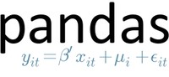
Python
What can Python be used for?
Web Development, Game Development, Data Science and Analytics, Information Systems
Web Framework
Data Analysis Library

Slide 13
Python Command Line
Windows : Run > Windows PowerShell
Windows alternative: Run > cmd
Mac : open Terminal
Type in: python --version
You should see “Python3.6.3”

Slide 14
Python Command Line
If the python command shows an error, might need to set path variables in the system settings.

Slide 15

Python Command Line(CLI)
Type: python
Hit enter
You should see python being activated in the command line window

Slide 16
Python Command Line (CLI)
Type in : print(“Hello World”)
Outputs “Hello World” into the CLI
Type in : quit
Displays instructions on how to exit the python shell

Slide 17
Python PIP
PIP is a package management system that comes with Python
Install libraries, packages and dependencies
Type in: pip install pygame --user

Slide 18
Python IDE
Integrated Development Environment (IDE)
We will use IDLE, python’s default IDE

Slide 19
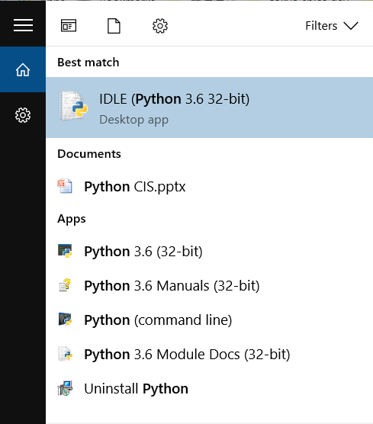
Python IDE

Slide 20
Hello World with PyGame
File > New File

Slide 21
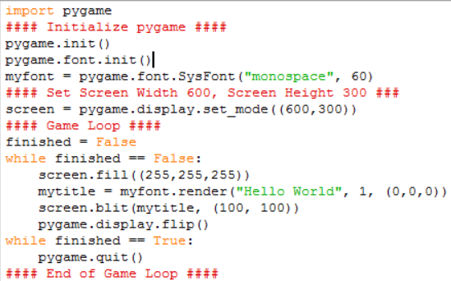
Hello World with PyGame
Notes:
1 hour mark

Slide 22
Hello World with PyGame
Save as helloworld.py
Click on Run in the menu
Or
Press f5 to run it

Slide 23
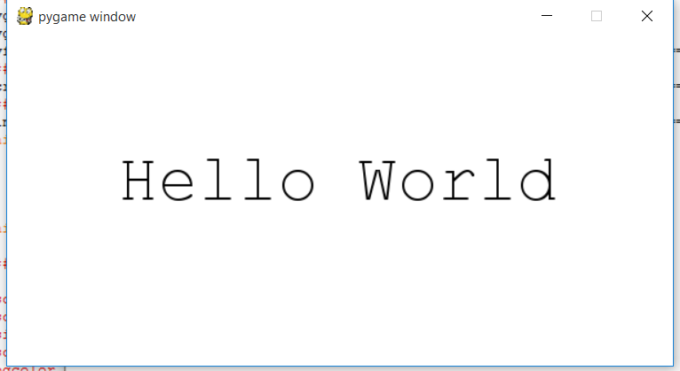
Hello World with PyGame

Slide 24
Programming Basics - Comments
# are for comments. What you write here will not be taken into the programme.
#Comments are important for you and other programmers to understand what your codes are for!

Slide 25
Programming Basics – Logic Loops
If
If… else
If…elif…
While
for

Slide 26
Programming Basics - Indentation
Indentation: to make your codes look cleaner and readable
In python, indentation is important to denote where the loop begins and ends
The spacing at the start of these lines are indentations
Press on Tab button to indent

Slide 27
Data Types
Boolean: True / False
str (String): “Strings are for texts. Double quotes are necessary”
int: Integers
[Arrays or Lists]: Like a bookshelf for variables
(Tuples): similar to Arrays and Lists. Used less frequently.

Slide 28
Data Types
Dictionary
myDictionary{“myname”:“DJ”,”mynumber”:200}

Slide 29
Spot the Data types
Find the data types in your PyGame Hello-World
Which is the Tuple?
Which is the String?
Which is the Boolean?
Which is the List?

Slide 30
Variables
Like algebra
x=2 # we are declaring that variable x is 2 in value. The type by default is int.
Apples = 2
Apples – x = ?

Slide 31
Lists
namelist = [“John”, “Tom”, “Harry”]
Index count starts from 0 from the left
To call the left most value in the list
we call namelist[0]
To call the right most value,
We call namelist[2]

Slide 32
Lists
namelist[0] gives us “John”
namelist[1] gives us “Tom”
namelist[2] gives us “Harry”

Slide 33
Lists
Numberlist = [20,60,9,10]
Our index will be from 0 to 3
Numberlist[3] – Numberlist[2] = ?
Numberlist[1] / numberlist[0] =?

Slide 34
Lists
Numberlist[0] – namelist[3] = ?
Error! Why???????????????

Slide 35
More on data types
Float: if you want more decimal places
Tuple: (12,21,35) – Fixed amount of elements
List : [12,21,35] -- No fixed amount of elements. Possible to add more to the list than previously defined/declared.
Datetime: system time datatype

Slide 36
Operators
Symbol
== | Equal to
> | More than
< | Less than
>= | More than or equal
<= | Less than or equal

Slide 37
Special Operators
Myvariable = 10
Myvariable = Myvariable + 1
How much is Myvariable now?
Myvariable += 1 is the same as the above expression

Slide 38
Exercise 1: Using Variables
Put the initializing values into variables:
screenwidth, screenheight,size,bgcolor
Save your changed program as “1_variable.py”

Slide 39
Exercise 1: Using Variables
screenwidth = 600 #type int
screenheight = 300 #type int
size = (screenwidth,screenheight) #type tuple
screen = pygame.display.set_mode(size)
bgcolor = (255,255,255) #type tuple
#(RED, GREEN, BLUE) play around with the colors

Slide 40
Clock Application
Let’s start with a clock application!
Save the 1_variable.py as a new file called 2_clock.py

Slide 41
Clock Application
2_clock.py:
import datetime #in lines 1 or 2
This uses python’s datetime library that is installed
No changes to the initialize block of codes

Slide 42
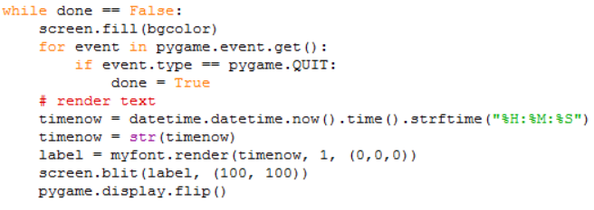
Clock Application
Use Tab button for indentation

Slide 43

Clock Application
Add behind the previous code at same level of indentation. Watch your indentation.

Slide 44
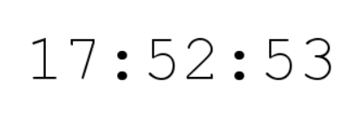
Clock Application
Run it!
Does it work?

Slide 45
Clock App Using functions
We can group a set of instructions into functions.
Functions can then be called into use in the codes.
Clearer and more modular codes
Save your current clock app to a new file called 3_clock_using_functions.py

Slide 46
Clock App Using functions
What is a function?
It is a set of instructions defined separately from the main program loop
Can be used to receive and output data
Cleaner looking code

Slide 47
Clock App Using functions
After the line “done = False”
Create a RunClock function that allows us to call it within the game loop

Slide 48
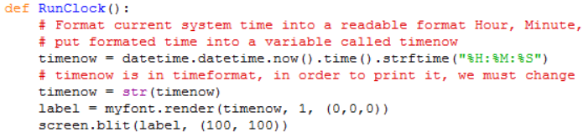
Clock App Using functions

Slide 49
Clock App Using functions
Press Tab button to indent.
Anything that is not properly indented will not be part of the function or loop

Slide 50
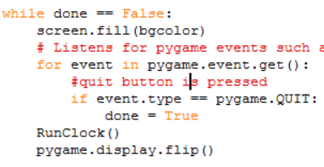
Clock App Using functions
Add: RunClock()
to before screen.display.flip()

Slide 51
Clock App Using functions
Run it!
Next we want to add a main menu
Save the clock with functions program to a new file called 4_clock_with_menu.py
We will work in this new file now

Slide 52
Adding Start Menu - Status Flags
A Flag is a variable we can use to monitor the program’s status and processes
Not Python specific, it is simply a variable
Are we using any so far?
E.g. something set to True or False

Slide 53
Adding Start Menu - Status Flags
done = False # this is the flag used to signify the end of the program
Let’s draw out the logic map for an clock app with a start menu

Slide 54
Adding Start Menu - Logic
Start Program
State: is_main_menu == True show_clock == False
Display Main Menu e.g. “Press Space to view clock”
Listen for Button to be pressed
State: is_main_menu == False show_clock == True
Show Clock & Hide Menu
Or
Hide Clock & Show menu

Slide 55
Adding Start Menu – Logic Codes
If is_main_menu == True and show_clock == False
If is_main_menu == False and show_clock == True
Display Main Menu e.g. “Press Space to view clock”
Show Clock & Hide Menu

Slide 56

Add Start Menu - Flags
In the same program
Set initial values of the 2 flags after done = False

Slide 57

Adding Start Menu – menu func
Main Menu Function

Slide 58
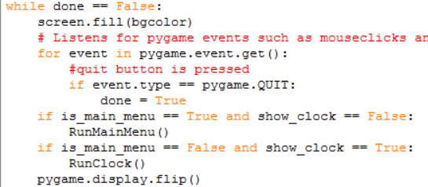
Adding Start Menu – menu func
If Loops

Slide 59
Adding Start Menu – listening for keys
Run it.
Does it show the main menu?
What about the clock?
Need to listen for key presses!

Slide 60
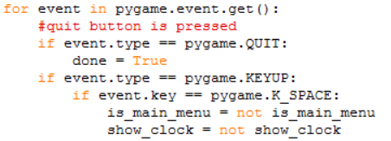
Adding Start Menu – listening for keys
Pygame.KEYUP listens for when the key is released
The “not” logic turns the current state to opposite. If current state is True, it will set to False, and vice versa. Using this is convenient but your logic must be sound

Slide 61
Adding Start Menu – listening for keys
Run it.
Does it show the main menu?
What about the clock?
Does it go back to main menu?
Save your work as 5_clock_menu.py

Slide 62
Group split
Split into 3 project/ discussion groups

Slide 63
PyGame Key List
https://www.pygame.org/docs/ref/key.html
Look around the documentation for Surfaces and drawing circles and rectangles
More explanations on blit function et cetera can be found

Slide 64
Pygame Essentials
pygame.init() calls pygame
Pygame.display.flip updates the display on the screen

Slide 65
Pygame Essentials
Basic block to write and display text on screen

Slide 66
Pygame Essentials
Screen coordinates
Different from mathematical graphs
(screenwidth,0)
(0,0)
(x,y)
(0, screenheight)
(screenwidth, screenheight)

Slide 67
Pygame Essentials
Pygame.event.get(): get current events that are happening, such as button presses, mouse positions clicks
event.key: sets which key to listen and respond

Slide 68
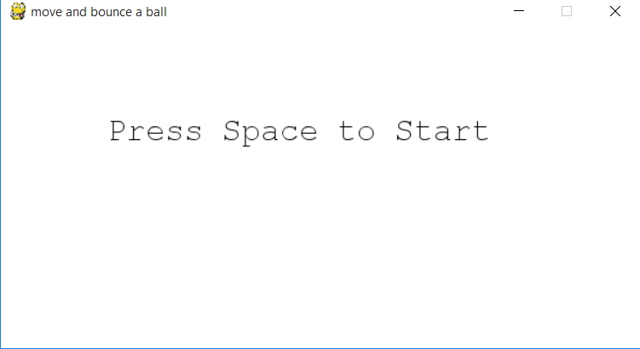
Ball Collision Game

Slide 69
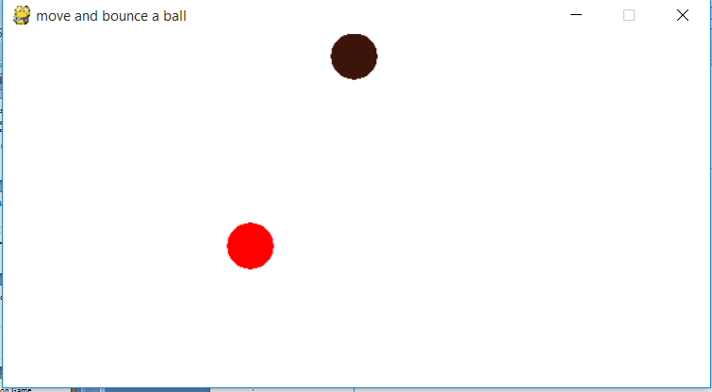
Ball Collision Game
Enemy Ball
Once collide, Game Over
Player Ball

Slide 70
Ball Collision Game
What do you think are the steps to create this game?
E.g. Step 1 is to draw the ball
What other steps do we need? Be specific!
5-10 minutes to discuss and tell us about it!

Slide 71
Steps to build our game
1 Draw the automatic Ball
2 Move ball by pressing spacebar
3 When ball hits boundary of screen, stops
4 When ball hits boundary of screen, bounce
5 Player ball movement
6 Player ball movement within boundary
7 Collison detection
8 Collision = gameover
9 Main Game Menu

Slide 72

Draw Ball
Download the template from HHHHH
Insert the following code after display caption

Slide 73
Draw Ball
Insert code before pygame.display.flip
pygame.draw.circle(screen,ball_color,ball_pos,20,0)
Run the program. Does it work?

Slide 74
Move the ball
Come up with the logic to create this ball which moves on it’s own.
Press Spacebar to start the ball movement
5 minutes. 3 steps
1. listen for ______
2. set _____
3. Change the ball’s _____

Slide 75
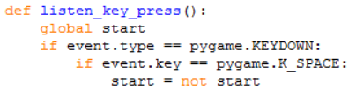
Move the ball
Add this to the appropriate place in the template

Slide 76
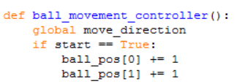
Move the ball
Add this to the appropriate place in the template

Slide 77
Move the ball
Before pygame.display.flip(), type the code in
ball_movement_controller()
Run the program. Press Spacebar.
Does it work?
What happens to the ball?

Slide 78
Move Ball with Boundaries
The ball will move out of your screen surface.
How to keep the ball within our screen boundary?
Hint: use an “If condition” in the ball movement controller

Slide 79
Move Ball with Boundaries
In the ball movement controller, after “start == True”, write the following code in one long line
if ball_pos[0] < screenwidth and ball_pos[0] > 0 and ball_pos[1] < screenheight and ball_pos[1] > 0:

Slide 80
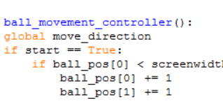
Move Ball with Boundaries
Your indentation should look like this. Use Tab to shift ball_pos.

Slide 81
Move Ball with Boundaries
Run the progam. Does it work?
Does it stop at the boundary?
It is only moving in one direction
Let’s randomize the move direction

Slide 82
Move Ball - Directions
Next, we want to set the ball to move in a random direction instead.
How do we do that?
Hint: we need a new function

Slide 83

Move Ball - Directions
Import randint(random integer) function from Python’s standard libraries

Slide 84
Move Ball - Directions
We set a new function set_dir()
def set_dir():
move_direction = {"X":randint(-ball_speed,ball_speed),"Y":randint(-ball_speed,ball_speed)}
return move_direction

Slide 85

Move Ball - Directions
Your indentation should look like this

Slide 86
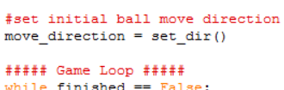
Move Ball - Directions
Add this line to set move_direction variable, before the game loop

Slide 87
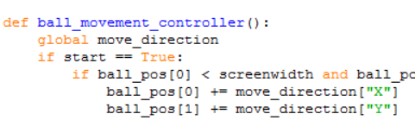
Move Ball - Directions
In the ball movement controller, change += 1 to += move_direction. See image below.
See the difference between lists and dictionaries?

Slide 88
Move Ball - Directions
What does set_dir() function do?
When function is called, it returns a value, which we use to set move_direction before the game loop starts
Move_direction is then used to set how much the ball_pos is changed

Slide 89
Move Ball - Directions
How does ball_speed = 1 come in?
An randomized output of set_dir() looks like this
X-coordinate | Y-coordinate
-1 | -1
-1 | 0
0 | -1
0 | 0
0 | 1
1 | 0
1 | 1

Slide 90
Move Ball - Directions
This means that the number of direction it is heading has only 9 directions, and one fixed speed.
What will happen if we change ball_speed = 2?
Total number directions will increase!
So will the speed, because the direction it is going can now be +-2 instead of +-1

Slide 91
Move Ball with Bounce
The ball now stops at the boundary.
How should we make it bounce?
Hint: we need a new function to handle boundary control
To bounce it, we need to
Detect that ball_pos is at the edge of our screen
Recall from the pygame basic template that the edge of our screen is set as screenwidth and screenheight

Slide 92
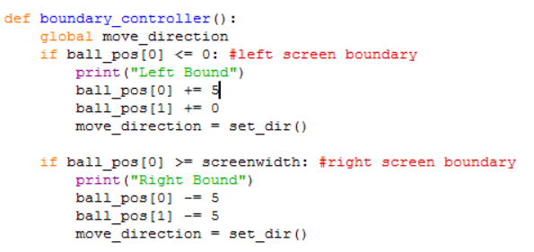
Move Ball with Bounce

Slide 93
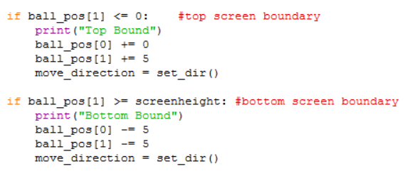
Move Ball with Bounce

Slide 94
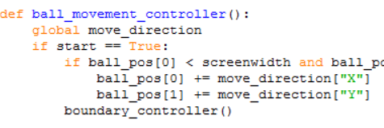
Move Ball with Bounce
Write code to call boundary_controller() from the ball movement controller function
We can call functions from within a function too!

Slide 95
Move Ball with Bounce
Run the code! Is it working?
Is it working well?
Is the system output showing your bound checks?
Why will it stop?

Slide 96
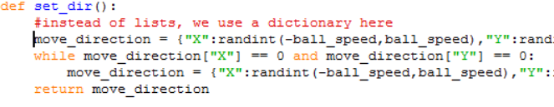
Move Ball with Bounce
When the move_direction is set to 0,0 it will stop in its place.
This while loop will regenerate the move_direction when it sets to 0,0. Write it in your code.

Slide 97
Move Ball with Bounce
Save your Ball Bouncing program as ball_bounce.py

Slide 98
Player Ball
Open the player ball template provided.
Notice the difference between this Game Loop
While done = not done
Another way of defining True / False for game loops

Slide 99
Player Ball
What are the steps to create a player controlled ball, starting from a blank screen?
Draw ball
Listen for key press
Move the ball when key pressed is true

Slide 100
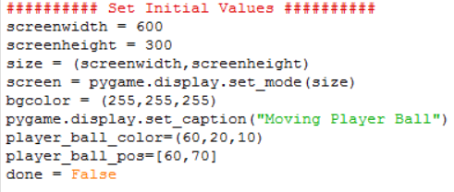
Player Ball
Initialize player_ball_color and player_ball_pos

Slide 101
Player Ball
Write the following code into the template
Set all button states for arrow keys to false

Slide 102
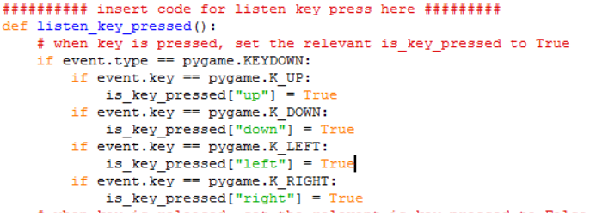
Player Ball – listen for arrow keys
Write this function in to your program

Slide 103
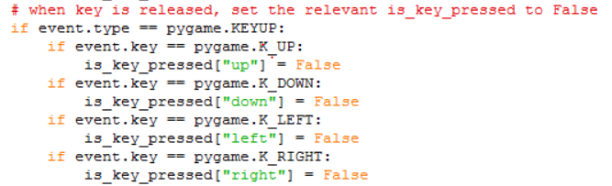
Player Ball – listen for arrow keys
Write this function in to your listen_key_pressed function

Slide 104
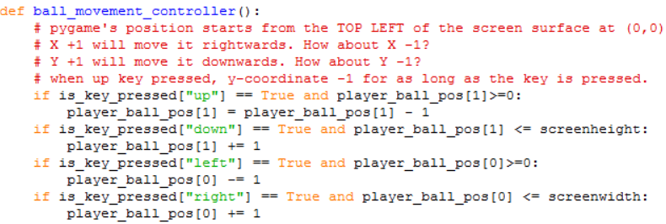
Player Ball – set boundaries

Slide 105
Player Ball – set boundaries
What do the if statements do?
It sets the boundaries for the player ball, just like your previous exercises

Slide 106
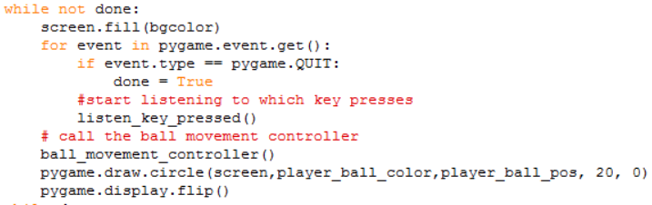
Player Ball
Call the ball_movement_controller function in your main game loop, and draw the player ball

Slide 107
Player Ball
Run the program. Can your ball move?
Does it move out of the boundary?

Slide 108
Player Ball
Change the player_ball_color to red
Google search for “red color RGB”
Replace the player_ball_color using the red color RGB values
Save it as player_ball.py

Slide 109
Combining Both Programs
Task: Take the code from player ball movement and put it into the ball bounce program
30 minutes-1hr
Hint: some of the “controller” functions can be combined

Slide 110
Remaining steps
Collision Detection
Game Over
Game Start Menu

Slide 111
Collision Detection
How do we detect collision?
5-10mins
Hint: think about the position of both the balls
Give us the logic

Slide 112

Collision Detection
Initialize a “ball_width = 20” variable

Slide 113
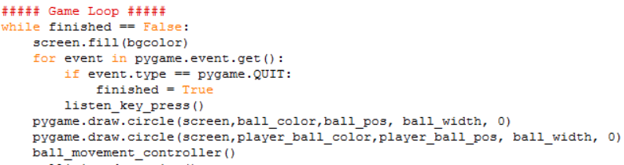
Collision Detection
Change the 20 width in the 2 circles to ball_width

Slide 114
Collision Detection
Declare a function for collision detection
def collision_detection():
if abs(player_ball_pos[0] - ball_pos[0]) < ball_width > 0 and abs(player_ball_pos[1] - ball_pos[1]) < ball_width > 0:
print("collision")

Slide 115

Collision Detection
Your indentation should look like this:

Slide 116
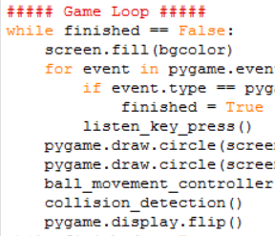
Collision Detection
Call collision_detection() in main game loop

Slide 117
Collision Detection
Run the program
Does it work?
Is collision detection showing in your system output?

Slide 118
Game Over
How do we set game over when collision is detected?
Hint: We need a new game state, we need to show something when game is over, we need to switch and display the correct screens when state is changed

Slide 119
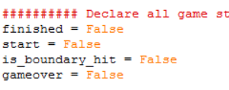
Game Over
Declare a state called gameover

Slide 120
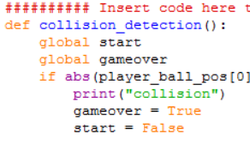
Game Over
Call the global gameover variable in collision detection function
When collision is happens, set gameover True

Slide 121
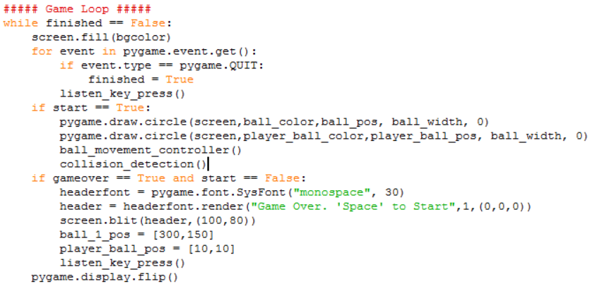
Game Over

Slide 122
Game Over – Game states
This is where the states come in handy
If start game is true, draw both circles and run the multiple game functions
If game over is true, we set start game to false as well for clarity. Don’t run the game functions and display a game over screen.

Slide 123
Final Project
Customize your game / Create a new game based on the things you learnt.

Slide 124
Final Project
Debug the game over bug when
Add a Start Menu
Add more balls
Change screen size
Change shape
2 player? Using WASD
Set difficulty parameters (more balls, different speeds etc)
Difficulty selection in main menu

Slide 125
Project Showcase
Your project’s name
Your project’s description
Your project demonstration
What did you understand from making this game, things you have learnt

